Slide 1
Feral Pest Tracking System
Team: DynamicMotion

Slide 2
Requirements
1. Register user account
2. Login
3. Logout
4. Update user profile
5. Register new pest
6. Update pest profile
7. Submit pest sighting
8. Automatically weekly report

Slide 3
Limitations
1. Hard to locate a specific pest
2. PHP technic

Slide 4
Documentation
document list:
1. Database.sql
2. Prototype:
2.1 javascript
2.2 image
2.3 css
2.4 updateSuccessful.html
2.5 userRegistration.html
2.6 pestRegisteration.html
2.7 managementReport.html
2.8 login.html
2.9 home.html
2.10 registrationConfirmed.html
2.11 canelRegistration.html

Slide 5
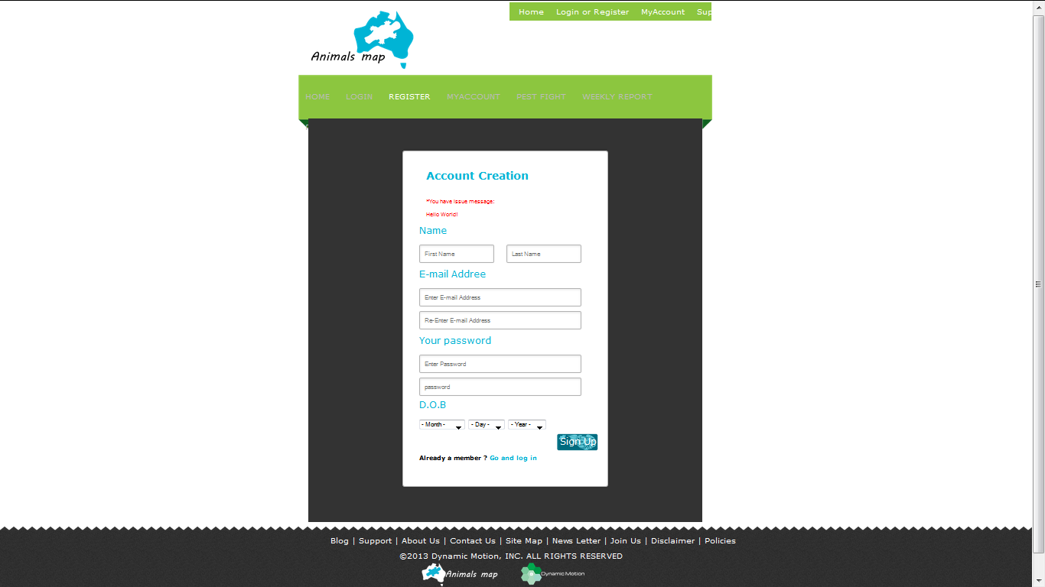
userRegistration

Slide 6
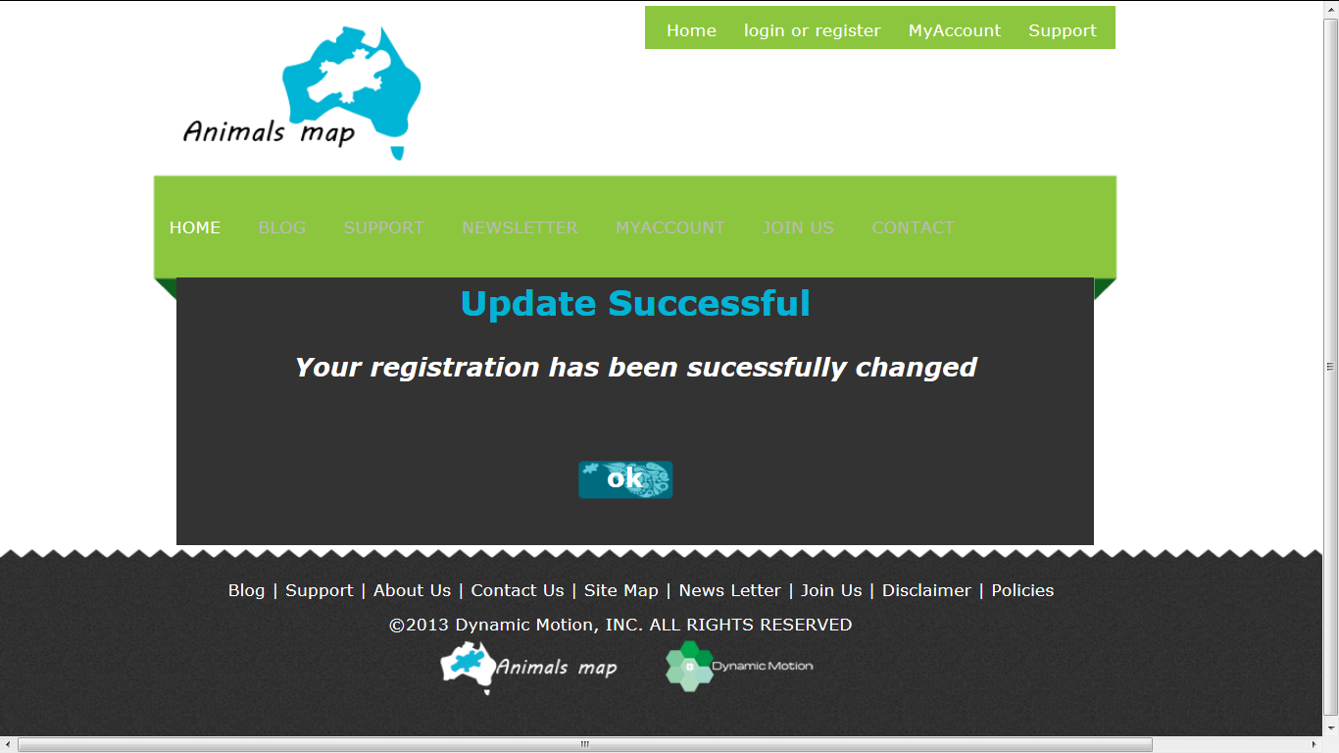

Slide 7
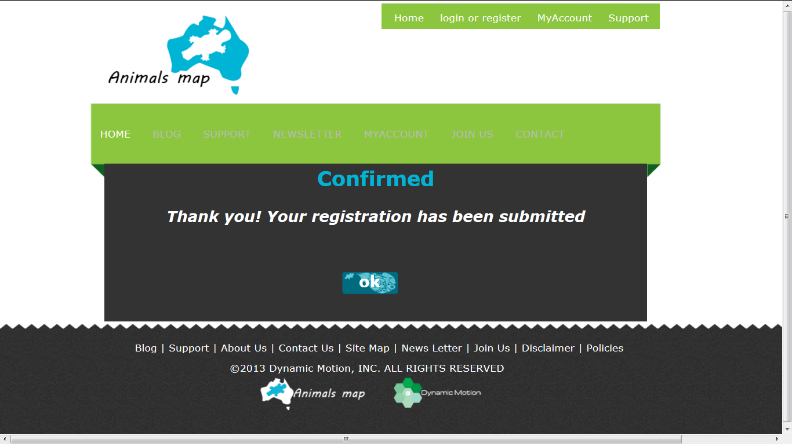

Slide 8
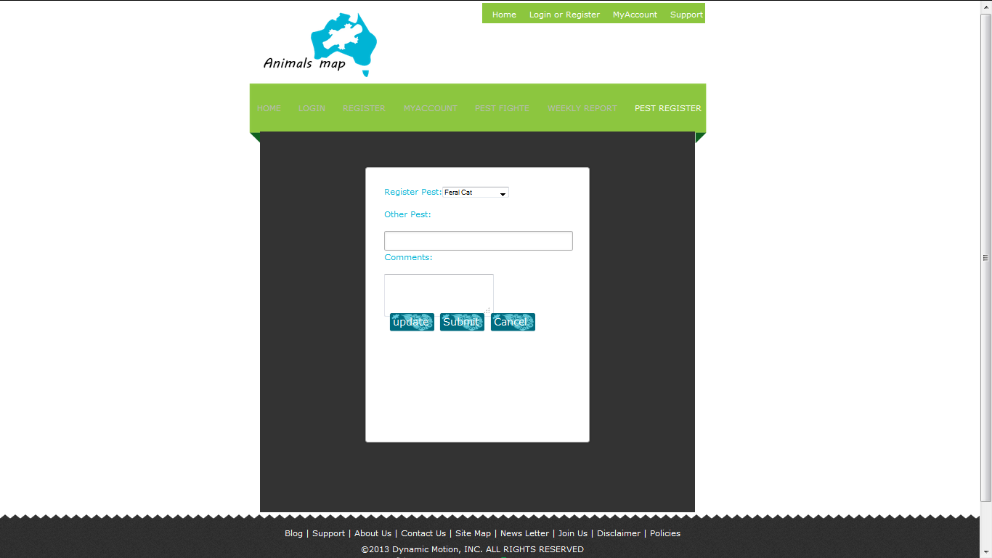

Slide 9
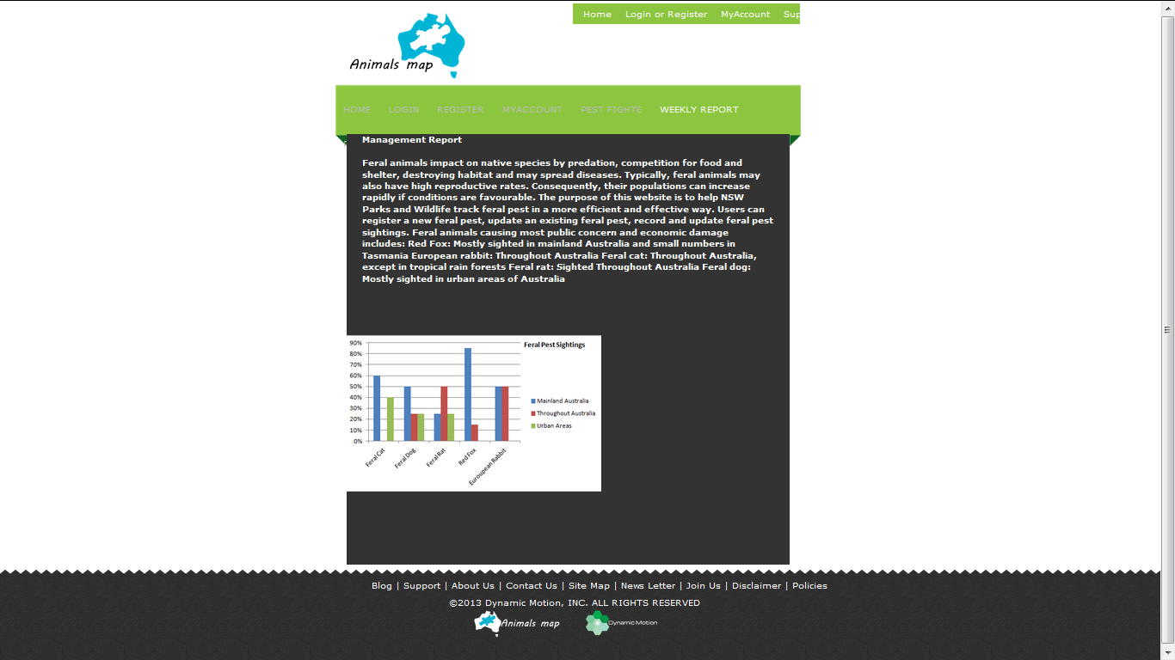

Slide 10
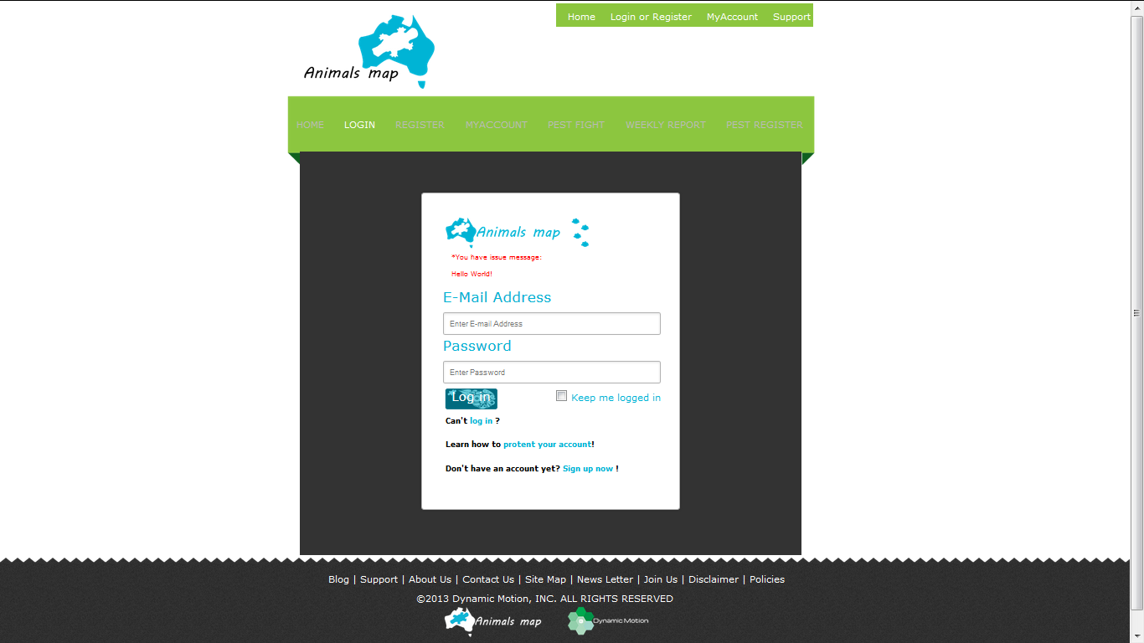

Slide 11
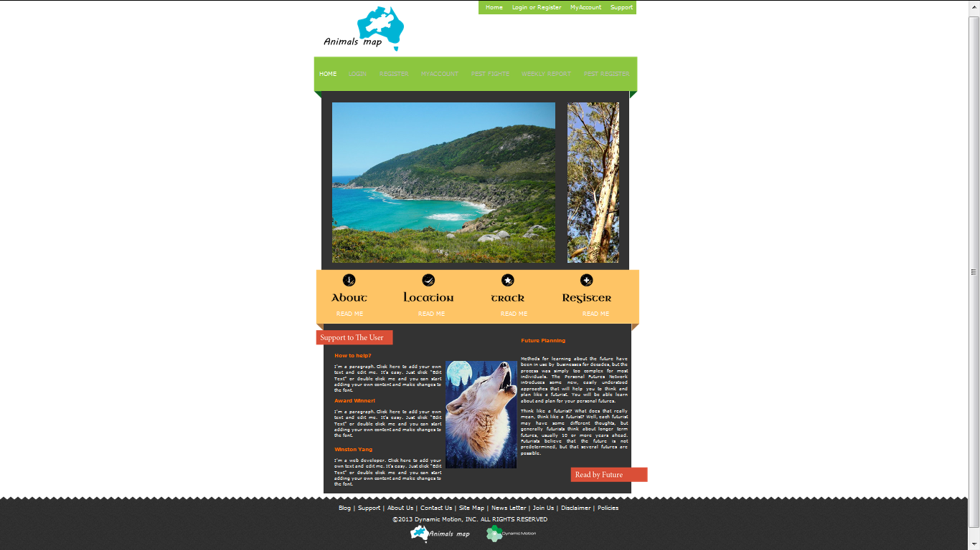

Slide 12
